Slide 1
Managing Kanban with Jira
Understanding Jira Issues, Agile Boards and Charts
Victor Grazi
Mitch Cox

Slide 2
Kanban Mantras
Make work visible
Limit Work in Progress
Measure and Manage Work
Prioritize effectively
Adjust based on feedback and metrics

Slide 3
Time Thieves
Too much Work in Progress
Unknown Dependencies
Unplanned Work
Conflicting Priorities
Neglected Work

Slide 4
Day to Day
Always use a fix version for traceability
Keep your Jiras flowing
Have daily standups to identify blockers, assign priorities, and move Jiras
Press the Jira “release” button when a release is done.
Clears everything from the Done column
Generates release summary report

Slide 5
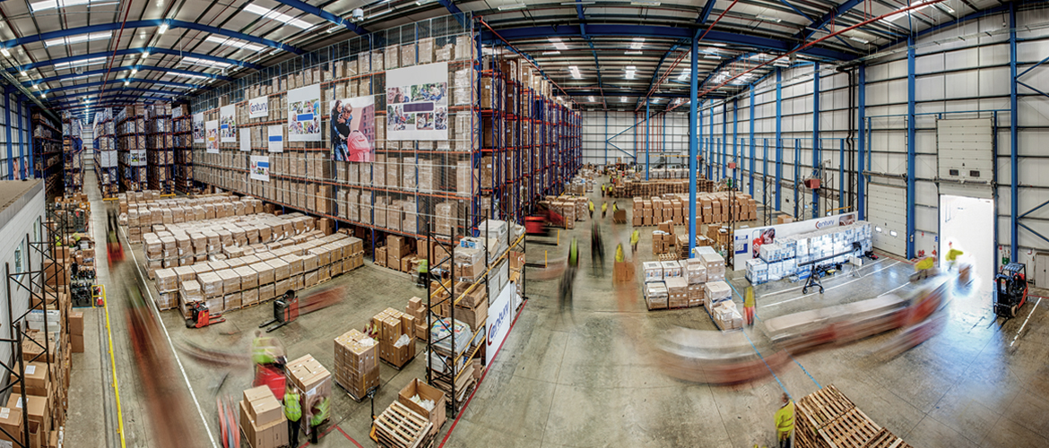
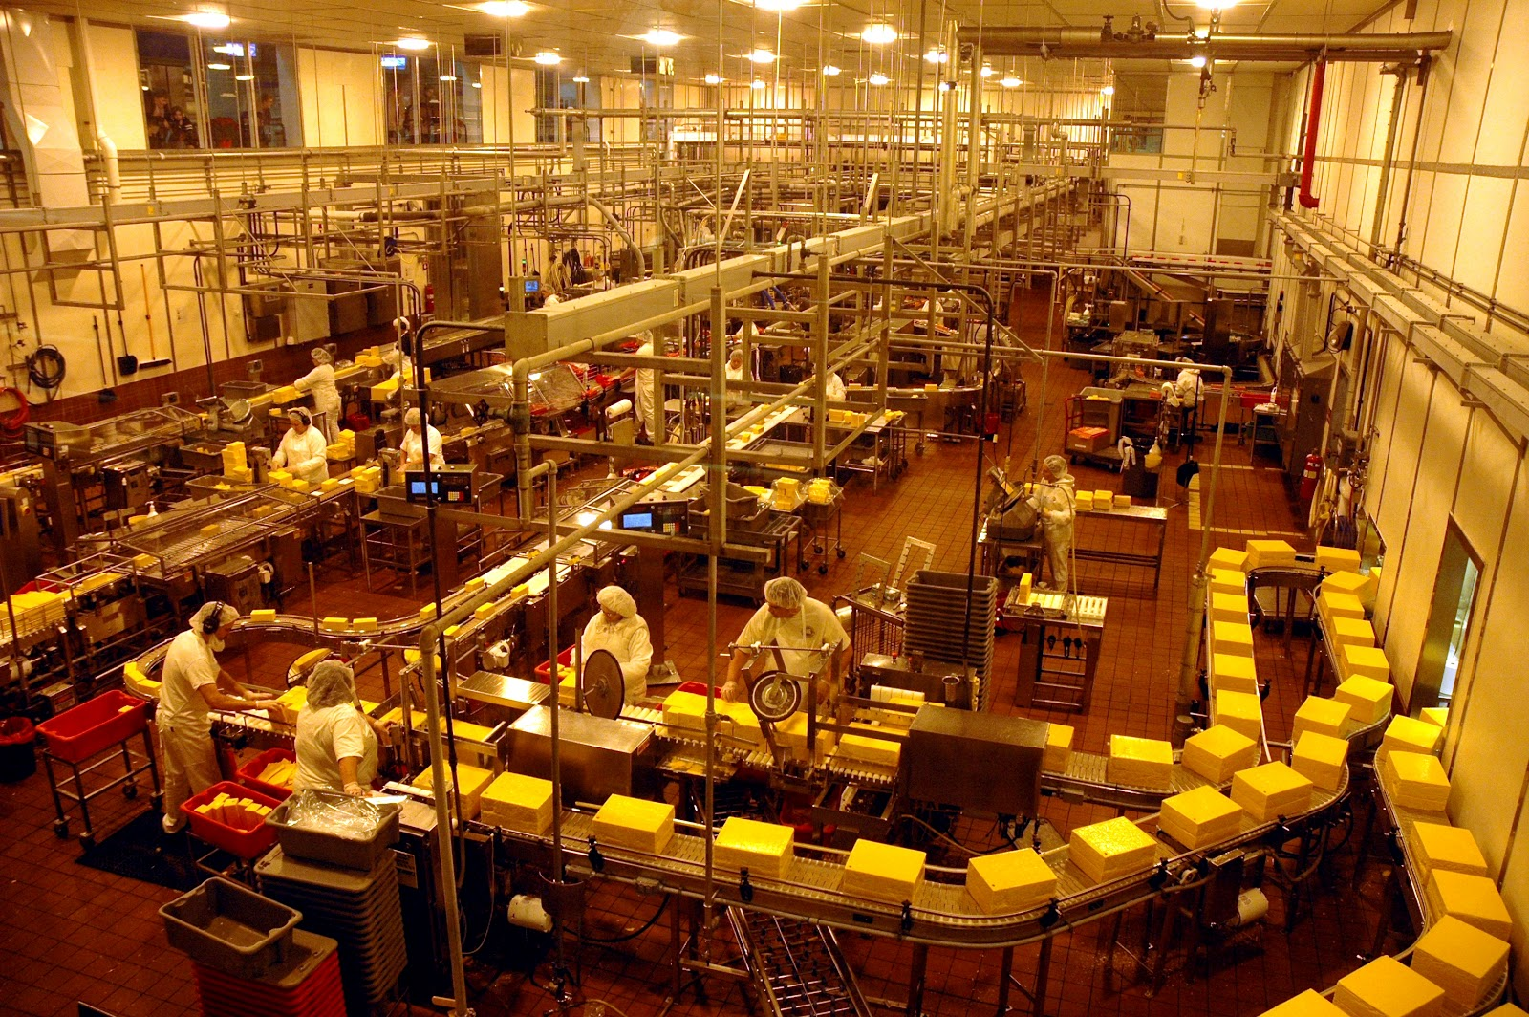
In a traditional factory it was easy to visualize the flow of work…
Traditional Flow Visualization
4/

Slide 6


But in a software shop, every desk looks the same.
Knowledge Workers Look Alike!

Slide 7
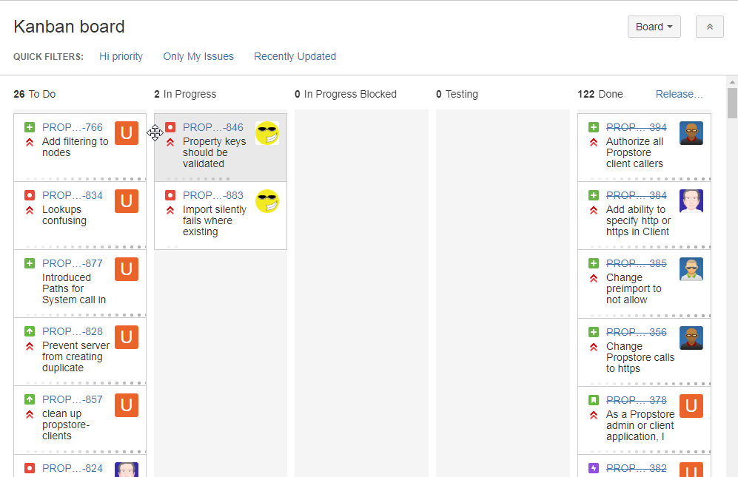
Icons show user
Dots show days in the column
Lead Time to Delivery
Cycle Time to Deployment

Slide 8
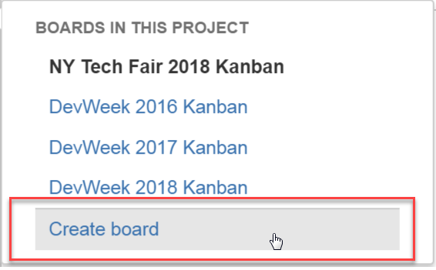
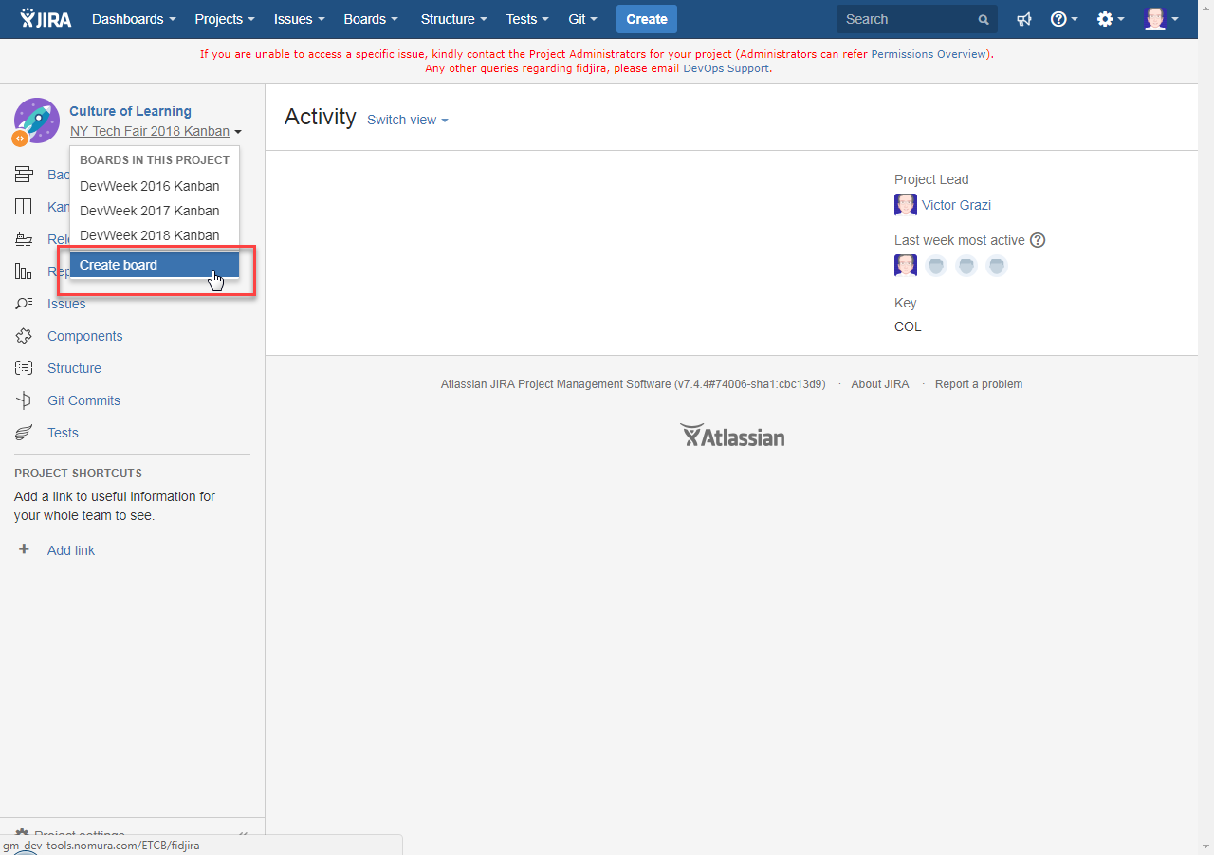
Create a new board

Slide 9
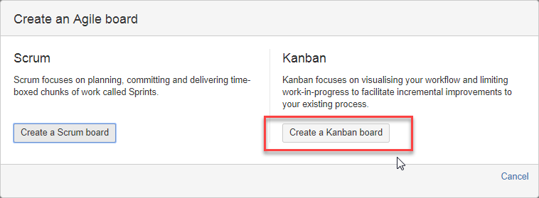
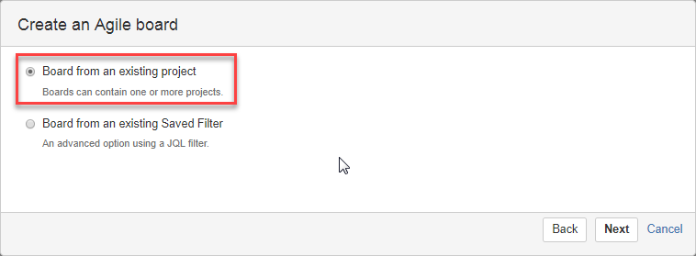
Kanban board or Scrum board (or both!)

Slide 10
Difference between Scrum Board and Kanban Board
Kanban
Exceed work in progress turns red
Wip limits
Days in column
No sprints
Scrum
Sprints
Backlogs

Slide 11
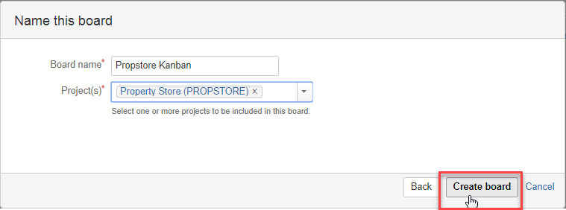
Kanban board or Scrum board (or both!)

Slide 12
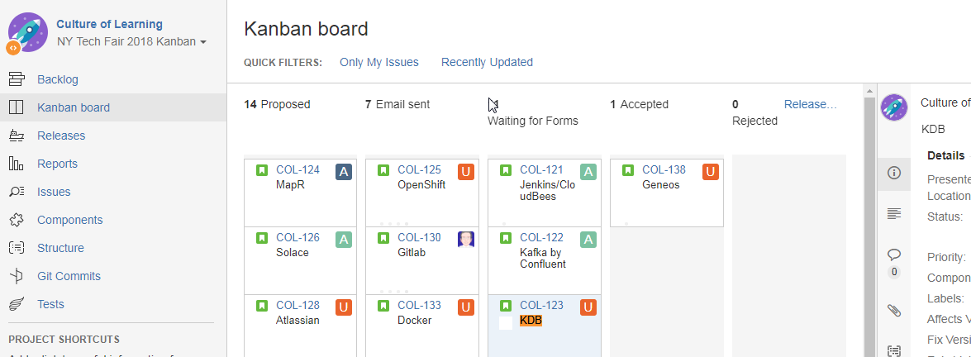
Backlog

Slide 13
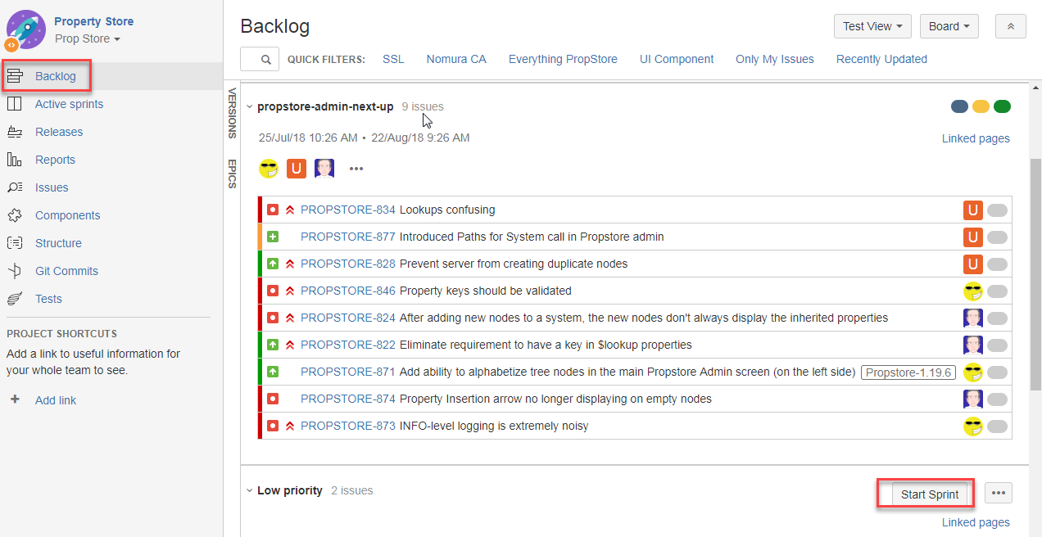
Backlog

Slide 14
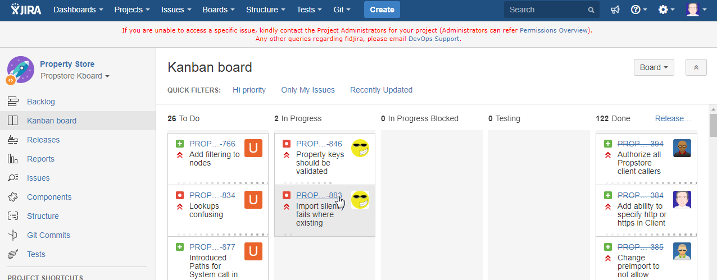
Backlog
Notes:
Point out that allowable columns are highlighted when dragging
The dragger becomes the assignee
Clicking a card shows the details on the right

Slide 15
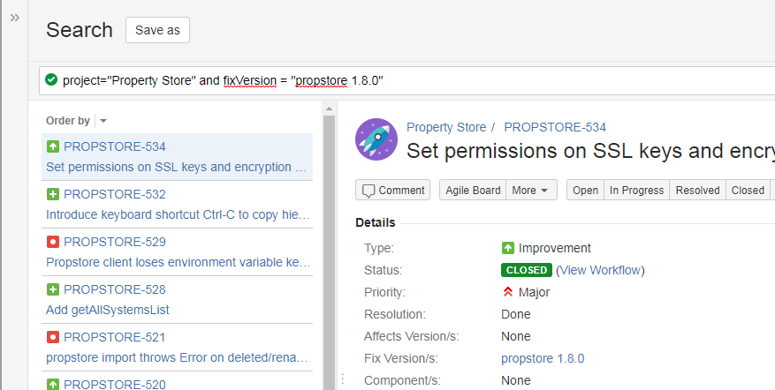
Filtering

Slide 16
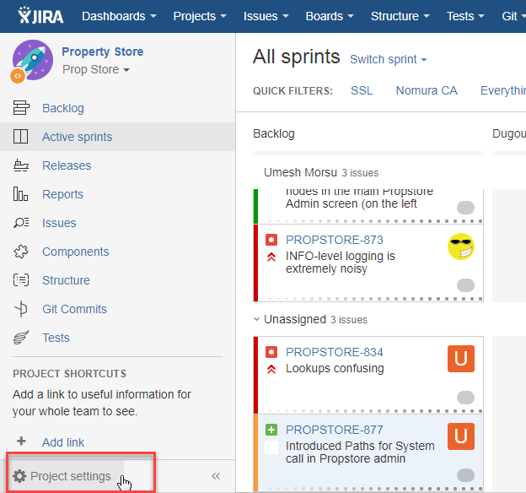
Project settings

Slide 17
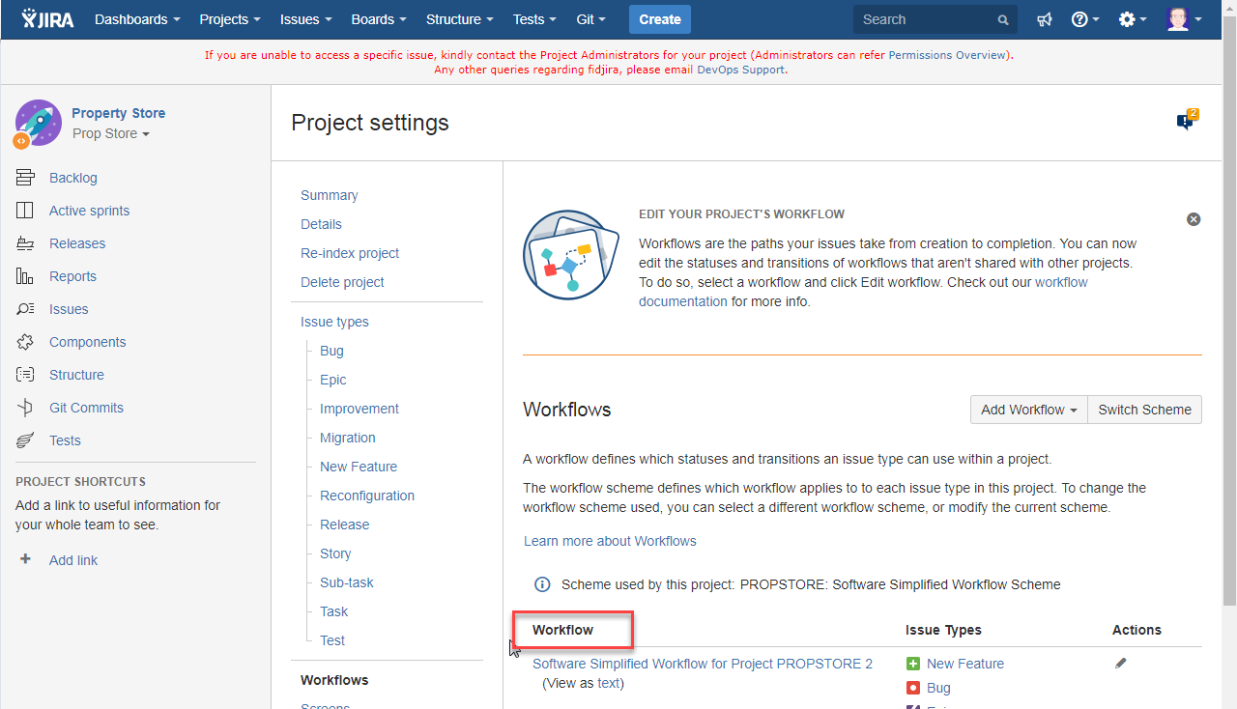
A workflow defines statuses, transitions, and resolutions, that describe the workflow of your Jiras
Notes:
Mitch

Slide 18
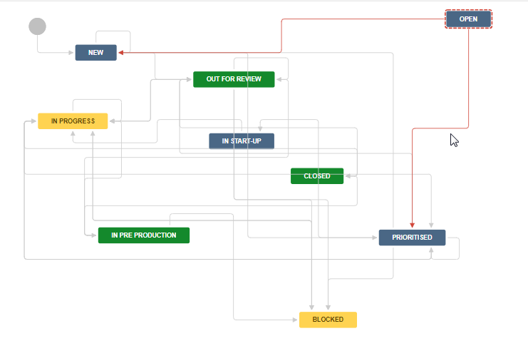
A workflow defines statuses, transitions, and resolutions, that describe the workflow of your Jiras
Notes:
Mitch

Slide 19
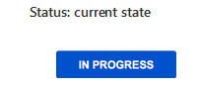
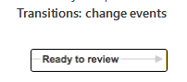
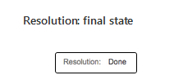
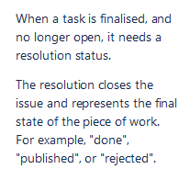
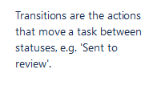
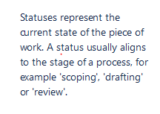
Key Workflow Components
Notes:
Mitch

Slide 20

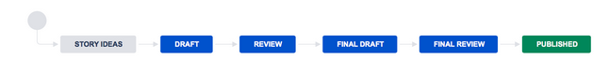
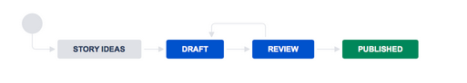
Story Ideas
Draft
Published

Slide 21
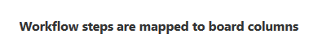
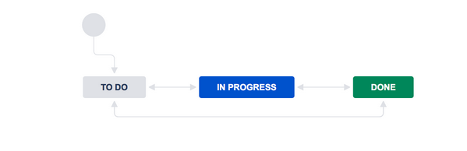
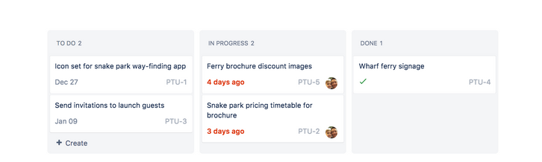
Notes:
Mitch

Slide 22
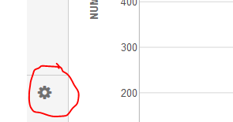
How can you tell your permissioned?
Notes:
Mitch

Slide 23
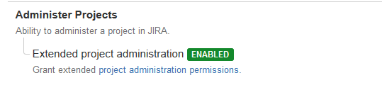
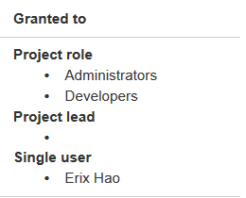
Permissions and Users and Roles (To Modify Workflow)
1. Must have the Administer Projects Permission granted to the Role
2. By Default this is granted to Administrators role
Notes:
Mitch Only people with project Administer Projects permission for your project can modify a worflow
To obtain this permission, email the project administrator

Slide 24
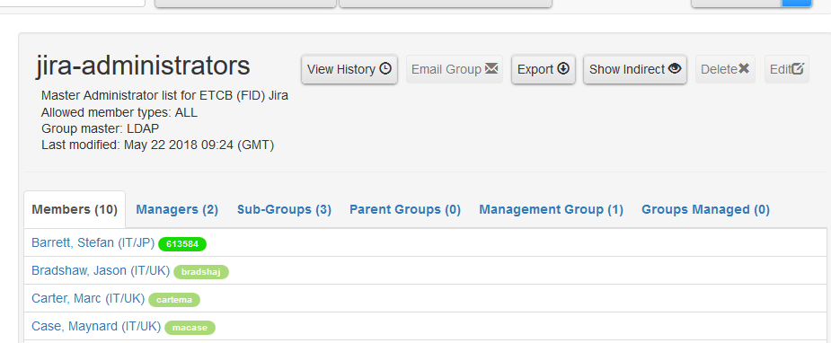
Permissions and Users and Roles (Create new or add additional workflows)
Or you can email DevOps Support <devops-core-prodservices-fidl@nomura.com>
Notes:
Mitch

Slide 25
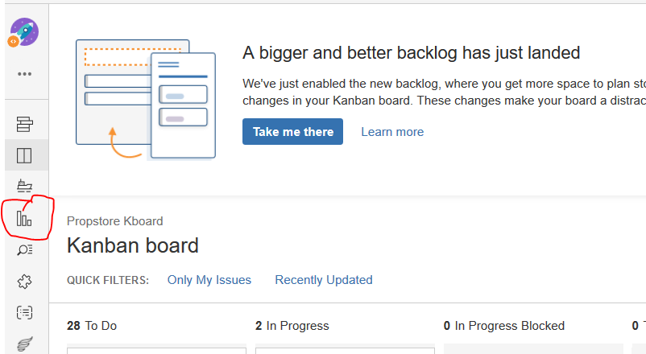
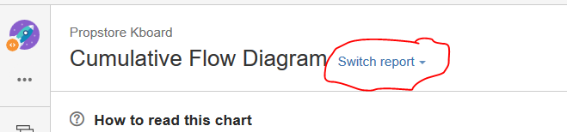
Reports:
Notes:
Victor

Slide 26
Workflow has four unique comments:
Statuses
Transitions
Assignees
Resolutions
Notes:
Mitch

Slide 27
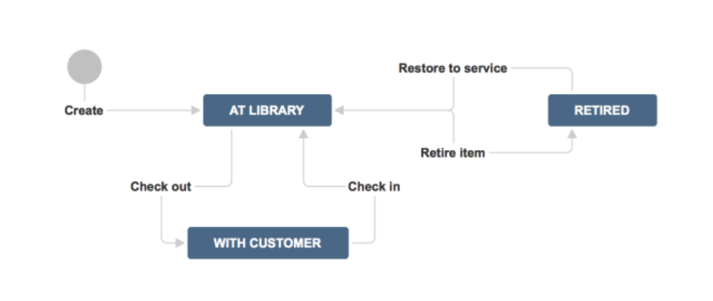
Notes:
Mitch

Slide 28
Status = Where
2 flavors: unresolved and resolved
Common open (i.e. unresolved) status names: Open, In Progress, In Review, Scheduled, Waiting on Customer, and Pending Analysis.
Common closed (i.e. resolved) status names: Shipped, Published, Fixed, Analysis Complete, and Closed.

Slide 29
Transitions = What
Reflects the action being taken and dictates the way an issue moves between states
Jira support workflow permissions
Librarians loan out books
Customers return books

Slide 30
Assignees = Who
Responsible party for an issue
Set assignee to the borrower of a book, clear when returned

Slide 31
Resolutions: why
Explains why an issue has transitioned from an open status to a closed one
Book removed inventory might have been retired
`

Slide 32
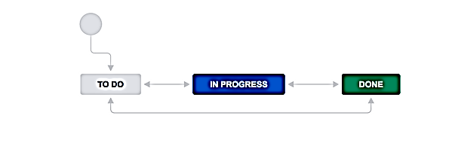
Workflow status maps to columns on a Kanban board
TO DO
IN PROGRESS
DONE
Notes:
Mitch

Slide 33
Gotchas
Workflow applies to the Kanban/Scrum Boards (Can’t just move stuff to any column; need to associate a workflow)
Confusing resolution with status
(e.g. Retired is a status; Damaged is a resolution – why it was retired)
Setting resolutions incorrectly (If you reopen, the previous resolution is still there)

Slide 34
Permissions and Users and Roles (To Modify Workflow)
Must have the Administer Projects Permission granted to the Role
By Default this is granted to Administrators role
Notes:
Mitch Only people with project Administer Projects permission for your project can modify a worflow
To obtain this permission, email the project administrator

Slide 35
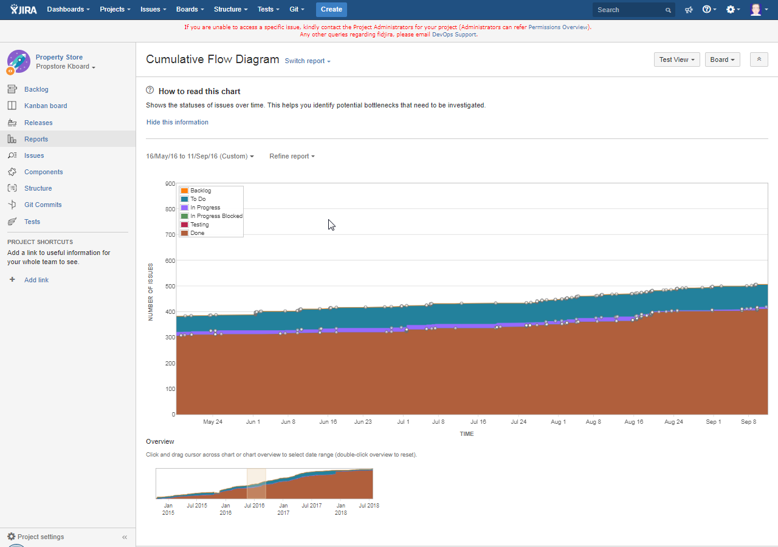
Notes:
Victor

Slide 36
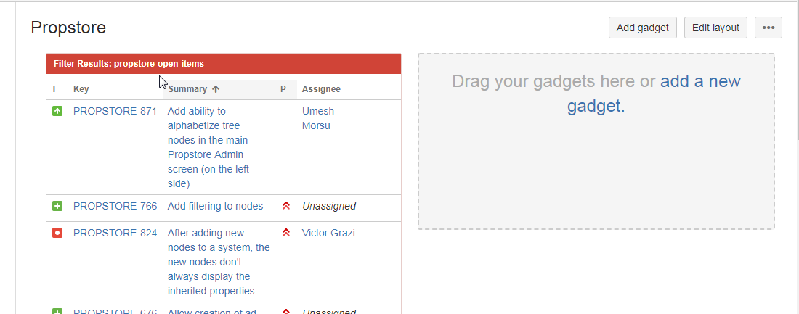
Dashboard

Slide 37
Todo
Bulk update
Dashboard
Structure
Notes:
Victor

